Slide 1
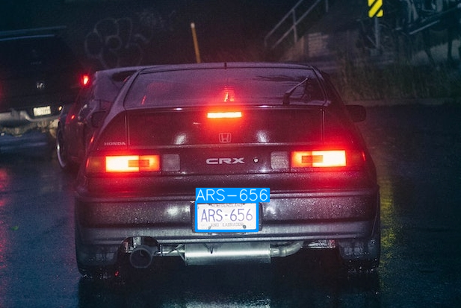
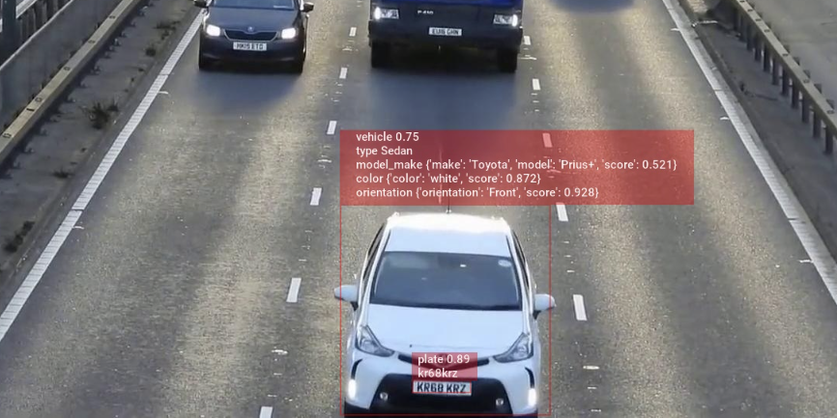
LICENSE PLATE RECOGNITION SYSTEM
2022-23
Team : Zerone

Slide 2

INTRODUCTION
License Plate Recognition (or 'number plate recognition') is a special form of optical character recognition (OCR).
It enables computer systems to read automatically the registration number (license number) of vehicles from digital pictures.
Reading automatically the registration number means transforming the pixels of the digital image into the ASCII text of the number plate.

Slide 3
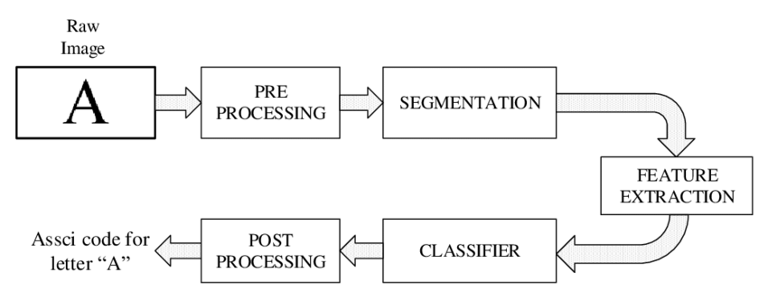
BASIC OCR
OCR technology scans paper documents and turn them into electronic, editable files.
IMAGE INPUT
INUT GIVEN IN DIGITAL FORMAT
FEATURE EXTRACTION
DETAILS THAT NEED TO BE RECOGNIZED
INTEGRATED TO AN OUTPUT PLATFORM
THE EXTRACTED OUTPUT WILL BE RETURNED TO USER

Slide 4
NEED IN INDIA?
High Population, has a unique set of needs for ANPR.
To monitor the vehicles’ average speed and can identify the vehicles that exceed the speed limit.
Maintain law and order which, in turn, can minimize the number of road casualties.
Cloud-based system for using the license plate data in :
Surveillance
Management
Visual Positioning Systems
Automated Toll Collection
Moreover, at an Individual’s and a societal level, It can be used as a utility or can be integrated with other systems to enhance their functionality

Slide 5
IMPLEMENTATION
SOFTWARE -
Python Libraries and Framework used-
Classifier: haarcascade : ML based for code simplification.
OpenCV : for this project in order to identify the license number plates In digital image
Pytesseract : for the characters and digits extraction from the plate.
FRONTEND -
Tkinter, flutter etc
HARDWARE -
A good FPS image capturing device.

Slide 6
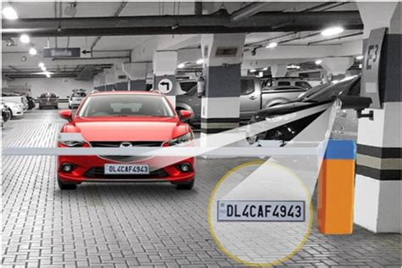
BASIC CONCEPT OF LPRS
DETECTION
CONVERSION
RECOGNITION

Slide 7
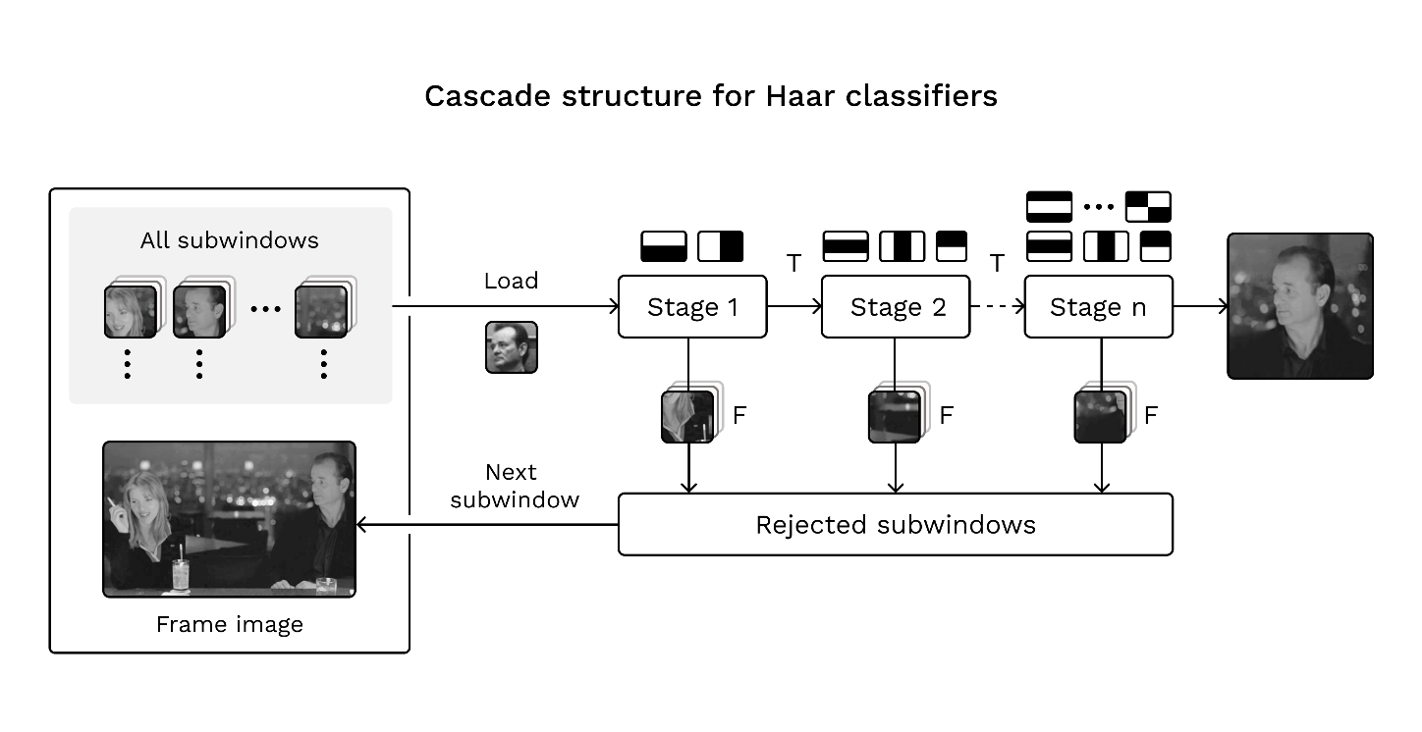
DETECTION
-we have used a classifier - haarcascade
haarcascade is a ML based model which is trained on tons of dataset and hence can detect objects from an image. In our case, it will detect number plate from the input image.
-you can use YOLO as well, but we have used Haarcascade for simplification of code.

Slide 8
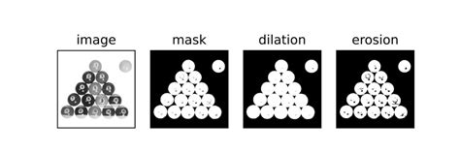
CONVERSION
IMAGE READING = CV2
Open CV computer vision library
Most powerful
contains 1000s of algorithms for identification
Built in C, C++
we have used techniques like gray conversion for converting the input image into grayscale and then performing required operations.
#Cropping number plate ->changing brightness and threshold/sharpening
-using dilate and erode of cv2 then converting again to b/w
-applying threshold

Slide 9
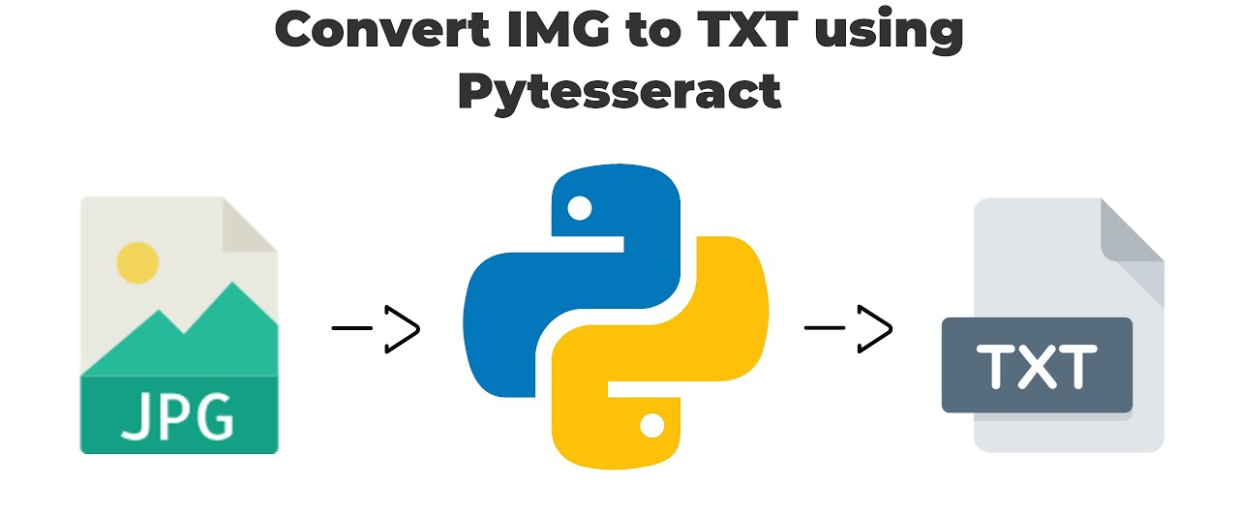
RECOGNITION
-you can use Deep Learning, CNN etc.
-we are using pre-trained OCR engine built by open source contributors
PYTESSERACT
-using "image_to_string " to convert all content into text
- use string processing to eliminate the extra characters [spaces and extra characters]

Slide 10
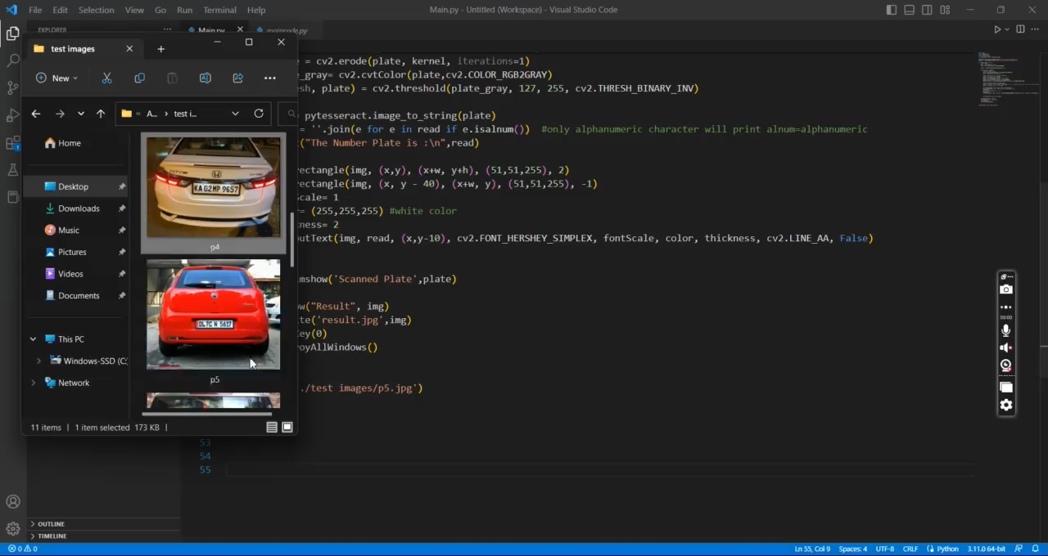

Slide 11
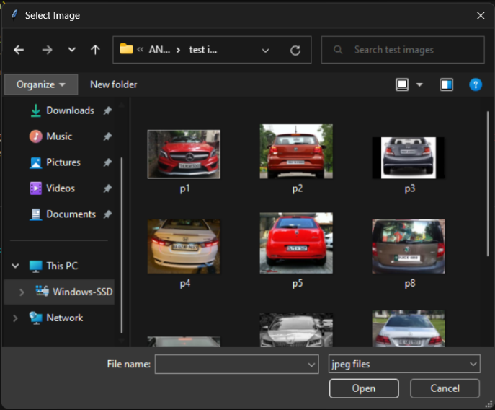
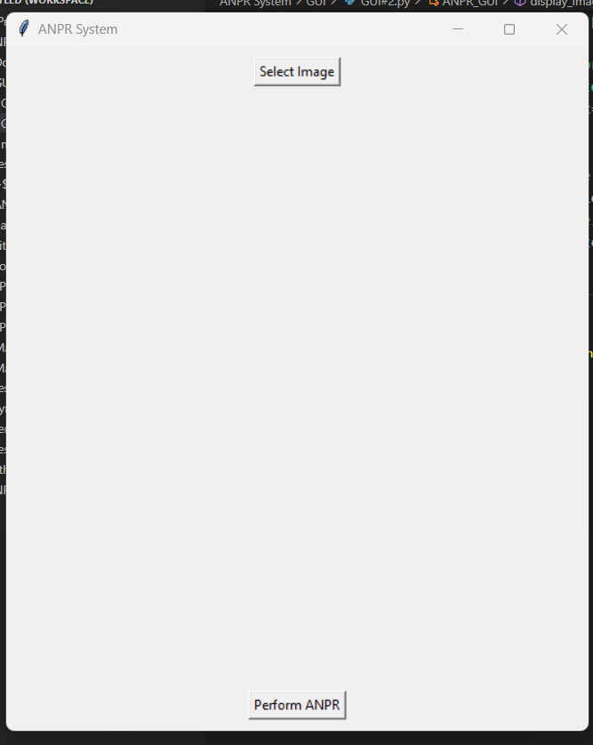
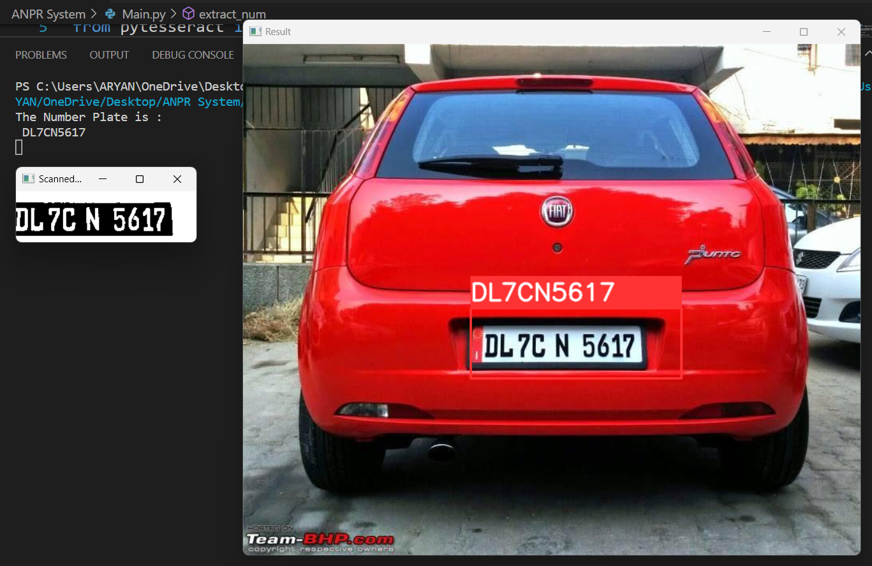
Input Image [ Still Frame or from device ]
Extracted Plate as “Text” / For Management and easy operations in DBMS

Slide 12
APPLICATIONS
Intelligent Transportation Systems (ITS),
security systems
motorway toll collection (highway toll collection),
traffic analysis,
police law enforcement,
vehicle theft prevention,
security monitoring of roads and checkpoints
vehicle surveillance

Slide 13
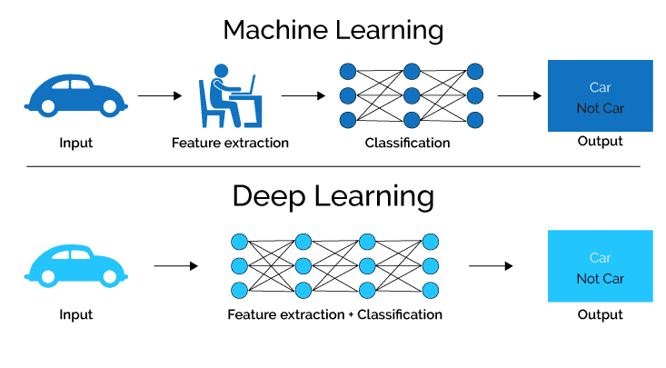
INNOVATION + CONCLUSION
FUTURE ASPECTS
The idea of OCR is basic, but its actual potential is yet to be discovered. Contributing to the same, we will try to implement it on real-time applications:
- Multiple Inputs
- Image/Video Capture
- As a utility for software
- Management & Surveillance
MACHINE LEARNING
DEEP LEARNING
NEURAL NETWORKS

Slide 14
REFERENCES
www.anpr.net
en.wikipedia.org
https://www.javatpoint.com
https://platerecognizer.com/anpr-for-india/

Slide 15
THANK YOU

